Slide 1
Amended Returns Prior Year Returns
Pub 4012 – Tab M Pub 4491 – Lesson 33
Notes:
Entire lesson is comprehensive

Slide 2
Lesson Topics
Amended returns
Reasons to amend
Amending in TaxSlayer
Printing
Assembling
Filing
State return
Creating original return not prepared by Tax-Aide

Slide 3
Amended Returns
Returns amended on Form 1040X
Can amend returns for current and previous three years only
State return may also need amendment
Amended returns must be mailed to IRS
Not eligible to E-file
Counselors must be certified for year amending
Additional certified counselor needed for QR
Notes:
Counselors can also prepare prior year returns if certified in year requested. Remember, must have additional certified counselor available to QR.

Slide 4
Reasons to Amend
Something reported incorrectly or omitted from original return
New or corrected information received by taxpayer
Should or could have used a different filing status
Mistakes
Omissions
Notes:
4
Generally, an amendment is requested by taxpayer

Slide 5
Reasons to Amend
Married individuals may amend to file MFJ if originally used different status
Up to three prior year returns
Must be legally married as of December 31 of year amending
Married individuals may not amend MFJ to MFS
After original filing deadline
Notes:
Same sex couples that filed single/HoH/QW May amend, but are not required
If filed MFJ and return accepted before April deadline, you can amend to MFS and mail 1040x before to April 15th. If both taxpayer and spouse do not amend, IRS will send letters to both.
After April filing deadline, cannot amend MFJ to MFS

Slide 6
Do Not Amend
Do not amend return if
Math errors
IRS will correct them
IRS has requested taxpayer provide missing schedules/forms
Taxpayer should respond per notice
Notes:
Do not need to amend return only to respond to IRS notice. May want to amend for other reasons but amending to agree with IRS notice is not necessary.
Math errors using tax software rare ... but possible.

Slide 7
Interview
Verify amended return necessary
Verify IRS changes or notifications
Confirm and note all changes needed on Intake Booklet
Notes:
The IRS communicates with the taxpayer by letter

Slide 8
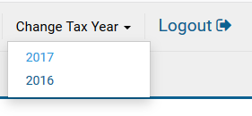
Amending in TaxSlayer
Must use TaxSlayer software for the year amending
Amending 2016, use 2016 TaxSlayer software
Choose which year you need from Change Tax Year dropdown list
If original return recently filed
Wait until IRS processes original return before submitting amended return
Notes:
IRS processes e-filed return in about four weeks

Slide 9
Amending in TaxSlayer (Continued)
Start by creating a corrected return
If originally filed at site, open and correct
If originally filed elsewhere, enter income, deductions, taxes and payments to make Form 1040 and any forms that will change identical to original return.
Go to 20XX Amended Return in left side menu
Notes:
See Tab M in Pub 4012
If creating a return that was filed elsewhere, no need to enter each income document. See Comprehensive Slides 24 and 25.

Slide 10
Amending in TaxSlayer (Continued)
Do the following steps in any order:
Enter or verify the original federal return information
Caution: verify original state filing before next step for changes that impact both state and federal returns
Make corrections to federal return
Describe the reasons for the federal amendment
Amend the state return if necessary
Notes:
Depending on specific state returns, you may need to verify and adjust the state original filing before making and corrections.

Slide 11
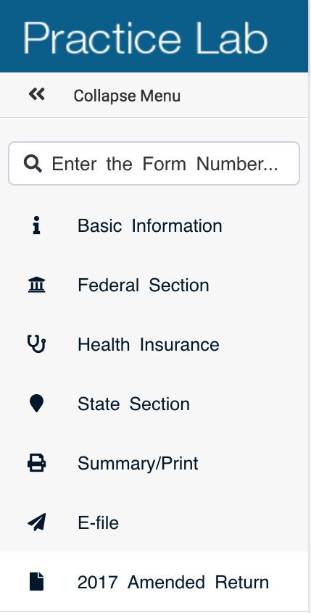
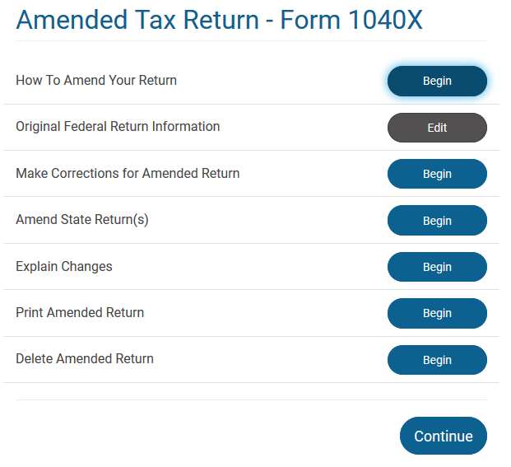
Amending in TaxSlayer
Always return to the 20XX Amended Return section to go to the next step.
Notes:
You can print the Form 1040X anytime. Click on Print Amended Return. This is a useful check to see what is actual in TaxSlayer as you update the Original Federal Return Information step. If you do not see the correct information in Column A, then fix in Columns A and C before proceeding.

Slide 12
Amending in TaxSlayer – State Returns
State amended returns may depend on Federal information
Important: Verify and match original state return information before making corrections to the federal
If original return was prepared elsewhere, create state return prior to making corrections to federal return

Slide 13
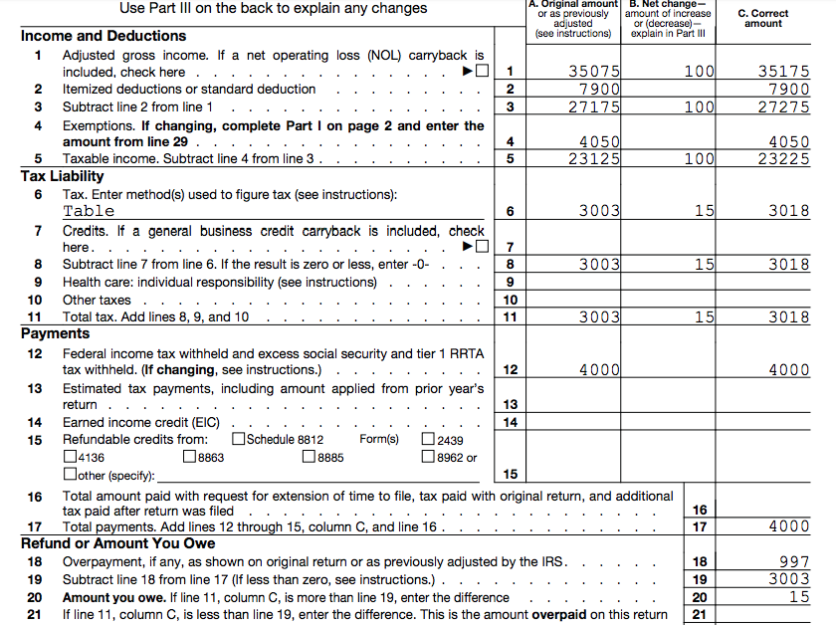
Amending in TaxSlayer
Explain all line changes. Print page 1 to view changes in column B.

Slide 14
Amending in TaxSlayer—Explanations
Notes:
Each line change must be explained. An increase in income that also increases taxable social security income must be explained to prevent additional IRS correspondence.

Slide 15
Printing Amended Return
Print Form 1040X and all new and any changed forms or schedules
Two copies plus one if needed for state
Print from Amended Tax Return screen
Generally, do not include new Form 1040 in print packet unless required by state
If included mark “As Amended”
Notes:
For example: If 1040X includes Schedule A itemized deductions with medical expenses, include a copy of Schedule A in packet if AGI has changed

Slide 16
Assembling Amended Return
Attach new and corrected tax documents
W-2, W-2G, or Form 1099 (if tax withholding)
Attach all new and changed forms and schedules
Include supporting documents, worksheets, etc. in taxpayer’s copy only

Slide 17
Filing Amended Return
Provide taxpayer with Form 1040X IRS mailing address
No cover letter required
Taxpayer/spouse sign and date copy to be mailed
Provide taxpayer copies for their records
Notes:
http://www.irs.gov/pub/irs-pdf/i1040x.pdf … url for 1040X Instructions
1040X must be mailed – find IRS address in TaxSlayer or print Page 5 (“Where to File”) of 1040X instructions

Slide 18
Amendment – Refund
Original return refund received on normal IRS schedule
IRS.gov “Where’s My Refund”
Form 1040X refund received within 8 to 12 weeks
After 12 weeks, contact IRS 800-829-1040
Refunds cannot be direct deposited
IRS check mailed to address on Form 1040X may include interest

Slide 19
Statute of Limitations – Refund
Taxpayers time to file for refund later of:
3 years from original due date or actual date filed if later
2 years from date tax was paid
State statute may differ
Exceptions to this statute are out of scope
Notes:
The regular statute for 2013 ended April 18, 2017 (originally due 4/15/2014 plus 3 years)
There are longer statutes for some items, such as claiming a loss on worthless securities or foreign tax credit. These taxpayers should be referred to a paid preparer

Slide 20
Amendment – Balance Due
Balance due with prior year amendment:
Taxpayer should file Form 1040X as soon as possible but after original return has been processed
Include payment to reduce penalty and interest
IRS will send letter with penalty and interest assessed
Do not include 1040-V (voucher)
Pay amount due on Form 1040X Page 1
Notes:
The Form 1040X serves as the voucher.

Slide 21
Statute of Limitations – Balance Due
Taxpayers owing additional tax
IRS barred by statute of limitation from assessing additional tax
3 years from original due date or date filed if later
No limitation if fraud involved
3 year statute of limitation does not apply if return never filed
Notes:
No statute to voluntarily amend and pay more tax

Slide 22
Amending State Return
When state only amendment required
If state requires federal amendment to be attached, amend federal and file with explanation of “Information Only: Changes did not impact the federal return however the return has been amended for state purposes”
Follow state specific rules for amending state returns
Notes:
Federal 1040X required by some states even though no changes
Insert state slides here

Slide 23
Creating Original Return Not Prepared by Tax-Aide
Only Form 1040 and any forms or schedules that will be changed need to be identical to original return

Slide 24
Creating Original Return Not Prepared by Tax-Aide
For other forms, you can enter totals only. For example,
Add W-2s together: Enter total of Boxes, 1, 2, 12 (by code) and state tax withholding
Add Form 1099-Rs together (separating pensions from IRAs)
For a business enter net profit as gross income with zero expenses.
For capital gains enter net gain as proceeds with zero basis (separating long term and short term).

Slide 25
Quality Review
Verify column A of Form 1040X agrees with last determined return
Confirm needed changes properly made and tax re-computed properly
Verify schedules and forms to be attached
Add TaxSlayer Tag and “Note” to document when and why amended return prepared
Notes:
The Amended Tag is a great search tool for EROs and LCs for reporting.

Slide 26
Taxpayer Summary
Review amended return with taxpayer
Verify taxpayer understands how to file amendment
Sign, address envelope, additional postage may be required
If payment required, include with return
Verify taxpayer aware of filing due date

Slide 27
Amended or Prior Year Returns
Comments ...
Questions?

